Slide 1

Software requirements (swr302)
The essential software requirement
(Chapter 01)

Slide 2
Contents
Why is requirement engineering?
Software requirements defined
Requirements development and management
When bad requirements happen to good people
Benefits from a high-quality requirements process

Slide 3
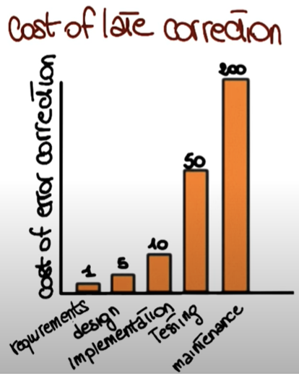
Why is requirement engineering?
Distribution of Effort to Fix Defects
Distribution of Defects
Code
1%
Other
4%
Design
13%
Requirements
82%
Code
7%
Requirements
56%
Other
10%
Design
27%
Source: Martin & Leffinwell
Notes:
Requirements Engineering (RE): is the process of establishing the needs of stakeholders that are to be solved by software
Stakeholders include customers, users, business analysts, developers, and many others
https://www.youtube.com/watch?v=5A5XCuWMG4o => Waterfall Model https://www.youtube.com/watch?v=YgkhFH8g0J4 => RUP Model https://www.youtube.com/watch?v=miuUIfpaC40 => RE Intro

Slide 4
Requirement Definitions
Brian Lawrence: “anything that drives design choices” (Lawrence 1997)
“Requirements are a specification of what should be implemented. They are descriptions of how the system should behave, or of a system property or attribute. They may be a constraint on the development process of the system”
Ian Sommerville and Pete Sawyer (1997)

Slide 5
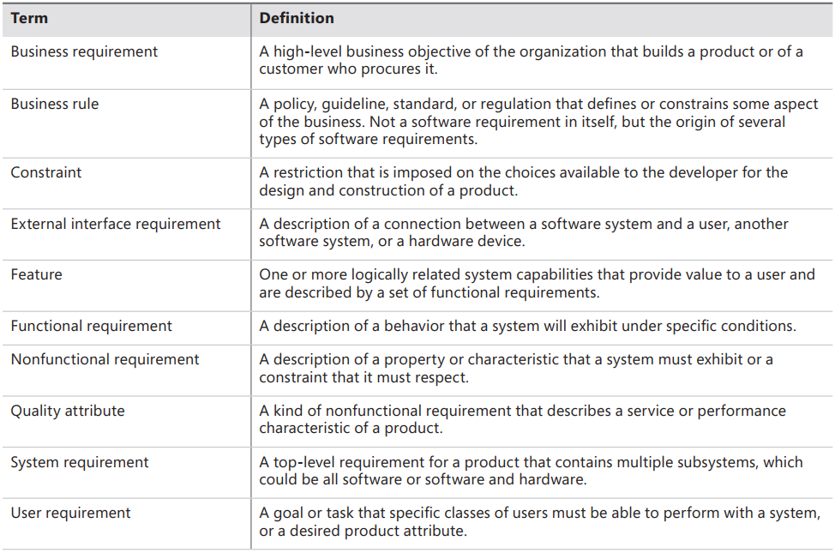
Requirement Definitions Types of requirements

Slide 6
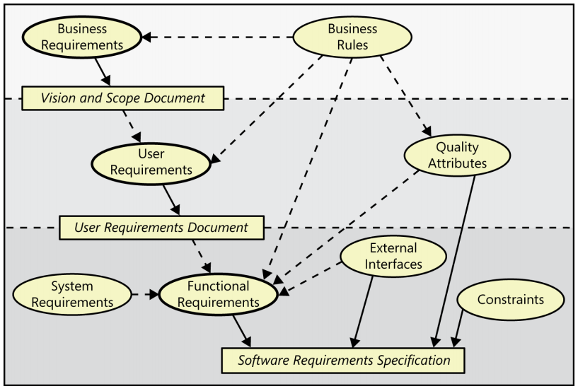
Requirement Definitions Levels & Types of Requirements 1/3
Notes:
Business requirements describe why the organization is implementing the system—the business benefits the organization hopes to achieve. The focus is on the business objectives of the organization or the customer who requests the system.
User requirements describe goals or tasks the users must be able to perform with the product that will provide value to someone. The domain of user requirements also includes descriptions of product attributes or characteristics that are important to user satisfaction. Ways to represent user requirements include use cases (Kulak and Guiney 2004), user stories (Cohn 2004), and event-response tables. Ideally, actual user representatives will provide this information. User requirements describe what the user will be able to do with the system.
Functional requirements specify the behaviors the product will exhibit under specific conditions. They describe what the developers must implement to enable users to accomplish their tasks (user requirements), thereby satisfying the business requirements. This alignment among the three levels of requirements is essential for project success. Functional requirements often are written in the form of the traditional “shall” statements: “The Passenger shall be able to print boarding passes for all flight segments for which he has checked in” or “If the Passenger’s profile does not indicate a seating preference, the reservation system shall assign a seat.”

Slide 7
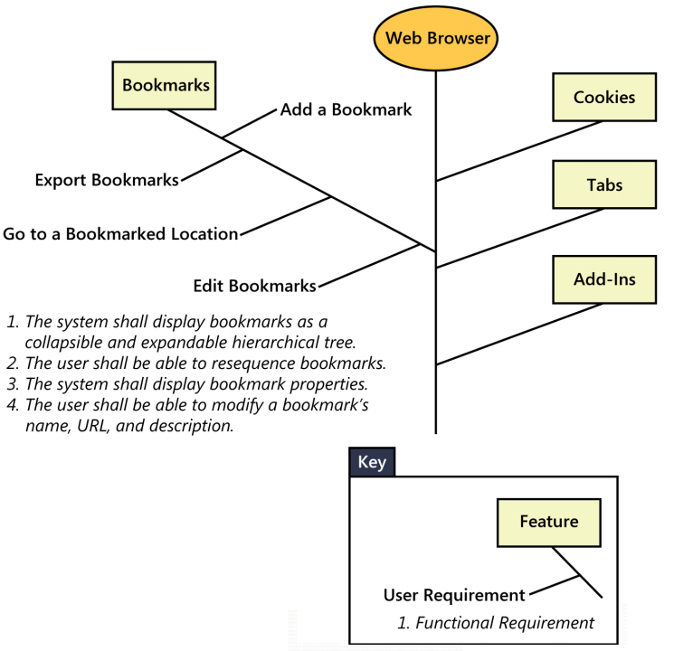
Requirement Definitions Levels & Types of Requirements 2/3
Requirement Concepts
BA
SRS
System requirements
Business rules
Quality attributes
System Features
Functional Requirement
Non-Functional Requirement
Product Requirement
Project Requirement

Slide 8
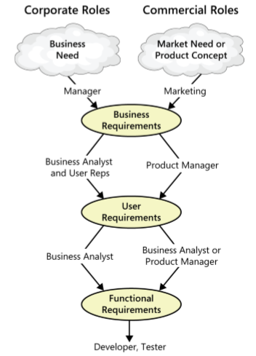
Requirement Definitions Levels & Types of Requirements 3/3
The participation of stakeholders in requirements development
Notes:
Working with three levels

Slide 9
Requirement Definitions Product vs. Project Requirements
Product requirements:
properties of a software system to be built
Projects requirements:
do have other expectations and deliverables that are not a part of the software the team implements, but that are necessary to the successful completion of the project as a whole
Notes:
Teacher should explain more detail about every type of requirements

Slide 10
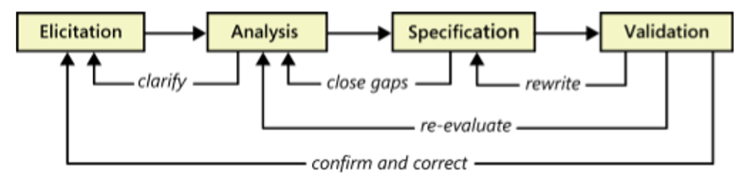
Requirements Development & Management
Requirement Development
Elicitation: encompasses all of the activities involved with discovering requirements (interview, workshop, etc.)
Analyzing: involves reaching a richer and more precise understanding of each requirement and representing sets of requirements in multiple ways
Specification involves representing and storing the collected requirements knowledge in a persistent and well-organized fashion
Validation confirms that you have the correct set of requirements information that will enable developers to build a solution that satisfies the business objectives

Slide 11
Requirements Development & Management
Requirement Management
Defining the requirements baseline
Manage requirement changes, negotiating new commitments based on the estimated impact of changes
Keeping project plans current with the requirements as they evolve
Defining the relationships and dependencies that exist between requirements
Tracing individual requirements to their corresponding designs, source code, and tests
Tracking requirements status and change activity throughout the project

Slide 12
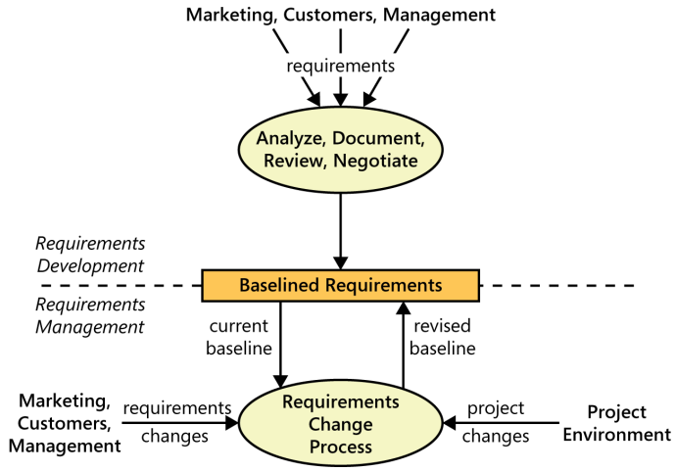
Requirements Development & Management
Requirement Management vs. Requirement Development

Slide 13
When bad requirements happen to good people
Insufficient user involvement
Inaccurate planning
Creeping user requirements
Ambiguous requirements
Gold plating
Overlooked stakeholders

Slide 14
Benefits from a high-quality requirements process
Fewer defects in requirements and in the delivered product.
Reduced development rework.
Faster development and delivery.
Fewer unnecessary and unused features
Lower enhancement costs
Fewer miscommunications.
Reduced scope creep.
Reduced project chaos.
Higher customer and team member satisfaction.
Products that do what they’re supposed to do.

Slide 15


